Slide 1


DSC 640 Project task 2
Aditya Sumbaraju DSC 640 – Data Presentation & Visualization Professor Catie Williams July 5, 2021

Slide 2
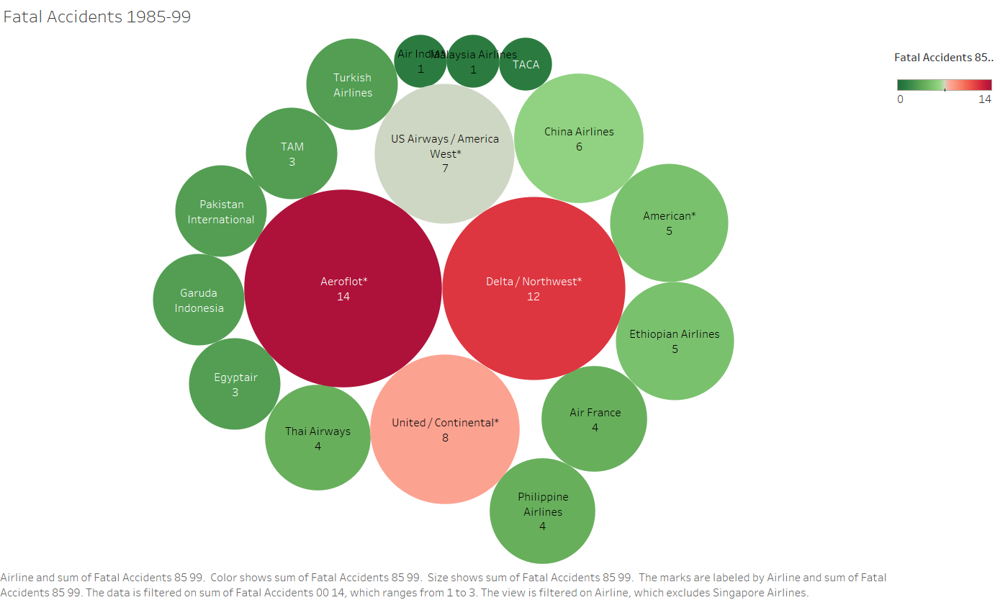
Red indicates – Bad performer
Green indicates – Good performer
Aeroflot contributes 14 fatalities in period 1985-99. Hence considered as bad Airline performer. American and Air India are considered as good Performer in terms of Passenger safety.

Slide 3
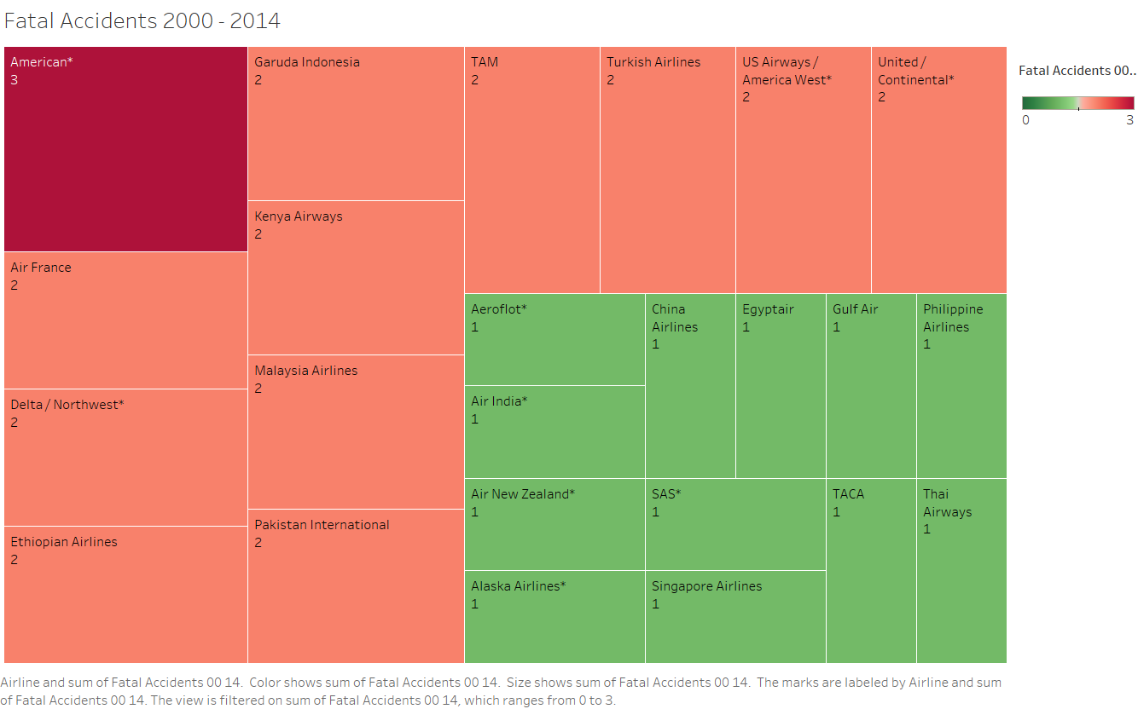
Red indicates – bad performer
Green indicates – Good performer
From the heatmap – we can identify that American airlines have contributed for the first time. But Aeroflot is still contributing despite of having modern infrastructure

Slide 4
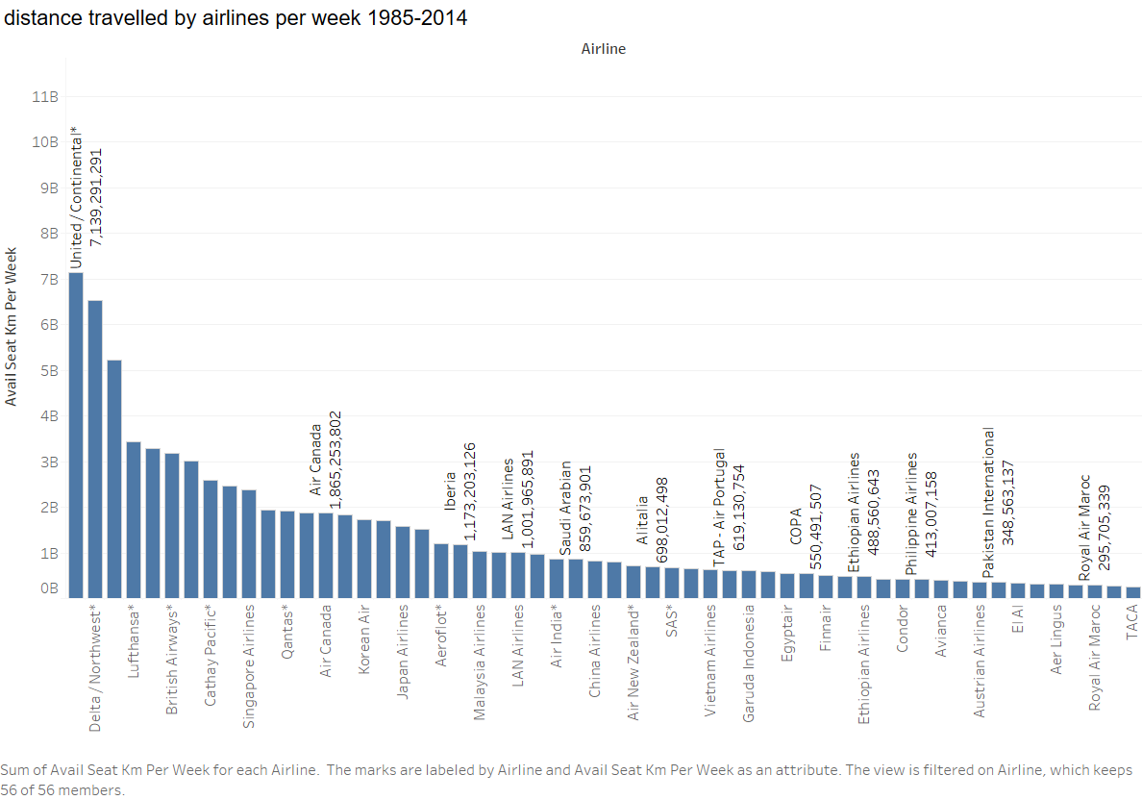
United and Delta airlines are the busiest airlines – and these airlines are categorized as safest airlines to travel among others

Slide 5
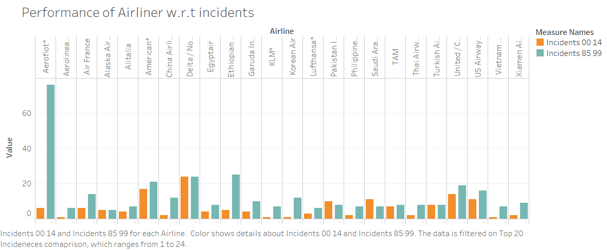
Aeroflot received huge spike in 85-99. KLM, American, Philippine are considered as best airways to travel due to decrease in incidents when compared to previous decade

Slide 6
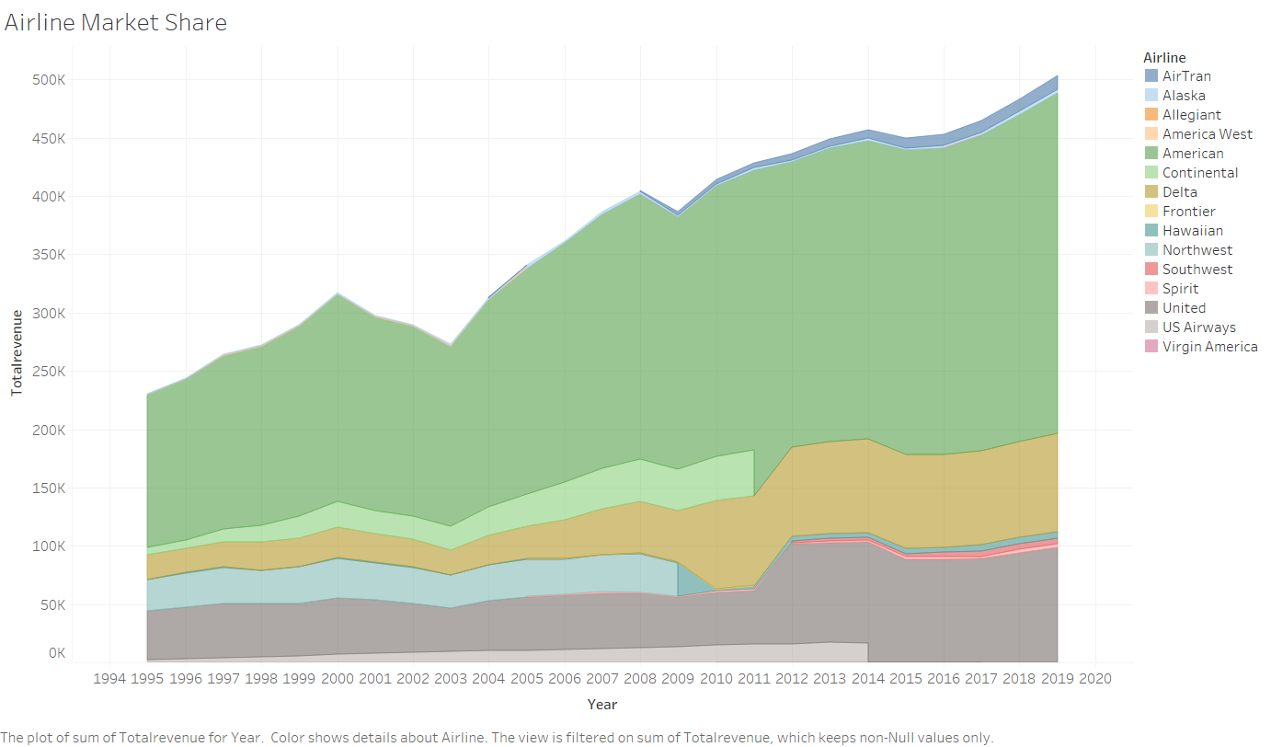
Stacked area chart represents the marketshare captured by airlines. American Airlines is the most opted airlines by passengers followed by Delta airlines.

Slide 7
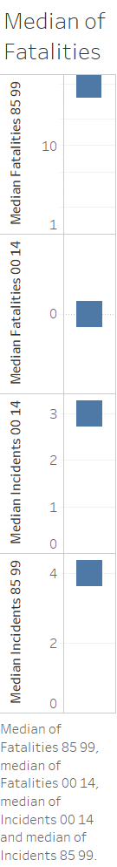
This plot represents the median values of fatalities and incidents. Median is 0 for fatalities occurred in 2000-14. And it is evident that the fatalities have drastically reduced over a period of time and hence it is safer to travel via airlines.

Slide 8
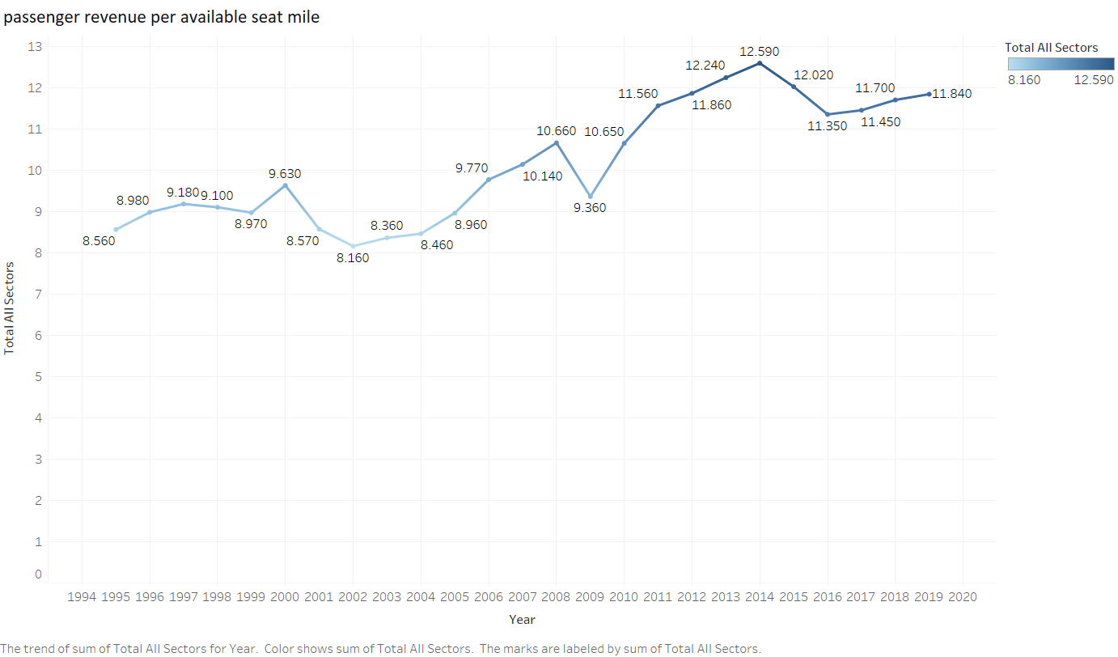
The line graph proves that despite media negative buzz on fatalities over air travel. Passengers were opting for the safest airlines for their travel and thereby increasing passenger revenue per mile. And this also proves that Airlines are the best means of long-distance travel.

Slide 9
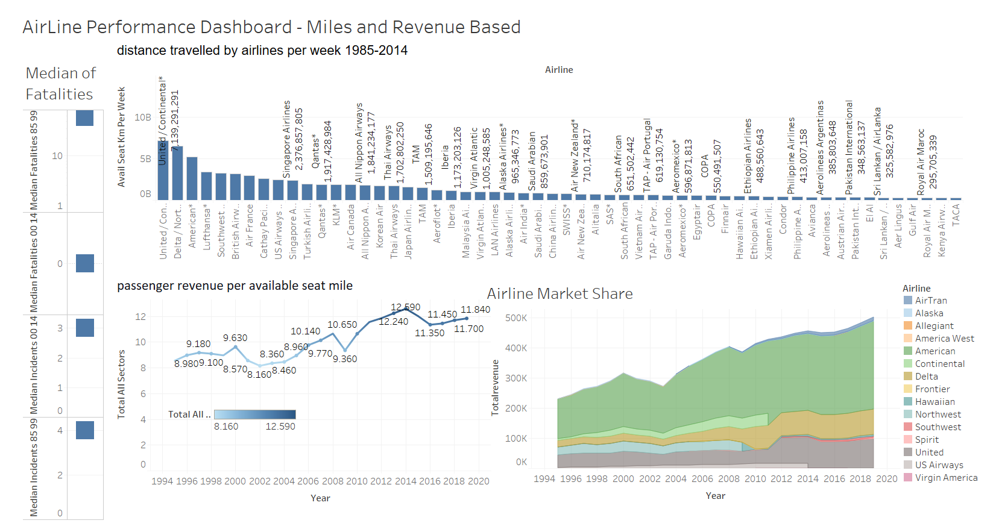
Dashboard 1

Slide 10
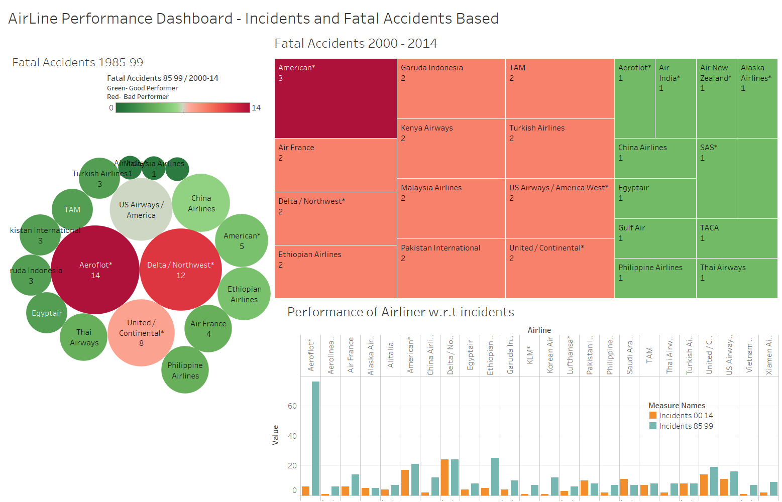
Dashboard 2

